Slide 1
Critical Thinking (BES-103)
Lecture 2
Why Develop Critical Skills?
Hadiqua Fazal
Assistant Professor
Computer Science Department

Slide 2
Lecture Outline
Why Develop Critical thinking?
Ancillary skills
Underlying skills and development
Self-awareness for accurate judgment.

Slide 3
Ancillary skills
Ancillary skills are skills that affect performance or address stressors that students commonly face but are not primarily academic or intellectual in nature.
Notes:
https://www.lwionline.org/article/ancillary-skills-and-law-school-success#:~:text=This%20article%20assumes%20that%20some,academic%20or%20intellectual%20in%20nature.

Slide 4
Ancillary skills
self-teaching
oral presentation
writing
Ancillary Skills
working in teams/groups
Patience
Time management
critically assessment

Slide 5
What Soft Skills Do I Need for Computer Science?
Attention to detail: In the computer science and IT field, attention to detail is vital. You must be able to look at long lines of code and identify anything amiss. Having an eye for small details can help you have a huge impact on projects
Creativity: Creativity is key to solving problems and creating functional, modern web applications and websites.
Communication: In the IT world, communication is key. This soft skill is vital to help you talk to clients, coworkers, and managers. Show you’re skilled when it comes to explaining your projects, objectives, and timelines.
Time management: Effective time management will help you stay on top of the various tasks and projects you’ll face.

Slide 6
What Soft Skills Do I Need for Computer Science?
Teamwork & Cooperation: Being a good team player is key in any organization, but it’s particularly important if you’re working in computer science. Many times, software engineers, data scientists, and IT professionals are expected to collaborate with a number of different groups within an organization to ensure timelines are met and expectations are fulfilled.
Analysis: You must be able to analyze hundreds of lines of code to troubleshoot and find solutions. Above all, being proactive is key, as it’s important to ensure quality at the creation stage to avoid costly fixes later.
Organization: Organizational skills are skills that allow you to use your resources efficiently and effectively.
Notes:
https://www.indeed.com/career-advice/career-development/organization-skills

Slide 7
Exercise
Analyze and write down what skills you have and the skills you wish to bring in yourself.

Slide 8
Underlying skills and development
When it comes to computer science and IT, there are a wide variety of programming languages that are vital to know.
C#
C++
Python
Asp.net
PHP
MERN Stack
MEAN Stack etc….
Notes:
https://www.worldbank.org/en/topic/skillsdevelopment

Slide 9
Personal performance and learning SHAPES
A reflecting tool to analyzing own performance
SHAPES stands for Skills, Habits, Attitudes, Preferences, Experience and Strategies. Understanding our own SHAPES for diverse activities can assist us in achieving our ‘peak’, or optimal, performance.

Slide 10
SHAPES
Skills: Skills, here, refers to abilities and techniques that help you to perform effectively at study or work – such as
Academic, People, Task, and Self-management skills.

Slide 11
SHAPES
Habit: A usual way of behaving: something that a person does often in a regular and repeated way.
Are you attached to any study habits or patterns of behavior that are not really helping your current study/work? If so, what needs to change?

Slide 12
SHAPES
Attitude:
an attitude refers to a set of emotions, beliefs, and behaviors toward a particular object, person, thing, or event.

Slide 13
SHAPES
Preference:
a greater liking for one alternative over another or others.

Slide 14
SHAPES
Experience: Our past experience shapes our readiness and confidence to take on new tasks, and the way we make sense of what is required.

Slide 15
SHAPES
Strategies:
a plan of action designed to achieve a long-term or overall aim.

Slide 16
Self-awareness for accurate judgment
“We must understand before we pass judgment”
—H. I. Marrou

Slide 17
Self-awareness for accurate judgement
In groups of three or more, discuss which word from each of the pairs below you think is more accurate. Which word in the pair would you prefer to use? Which would you prefer to see used by writers and speakers? How would the context influence your judgment? The words in the right column might be considered euphemisms or politically correct terms.

Slide 18
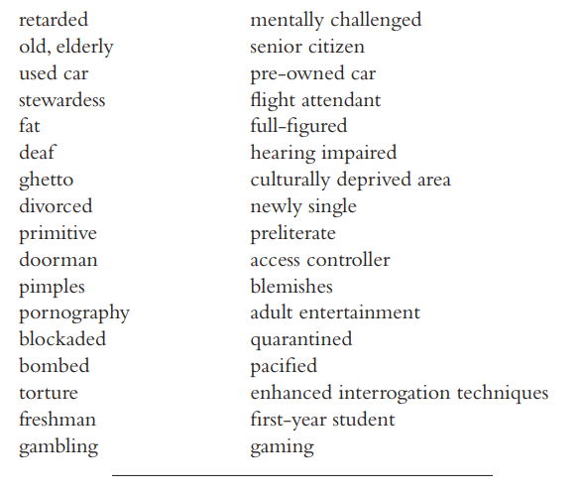
Self-awareness for accurate judgment

Slide 19
Reference
https://www.wgu.edu/blog/computer-science-skills-resume1911.html#close
Encyclopedia of Tourism
Anand, Paul, 1993, “The Philosophy of Intransitive Preference”, Economic Journal, 103: 337–346.

